Slide 1
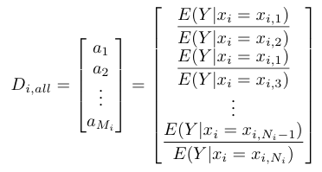
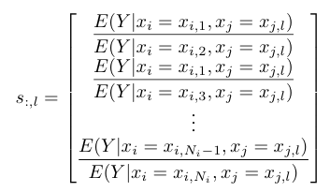
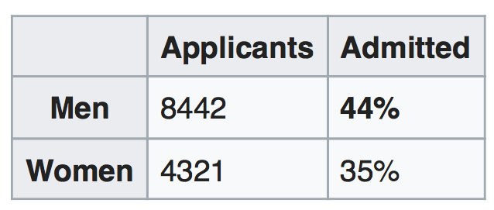
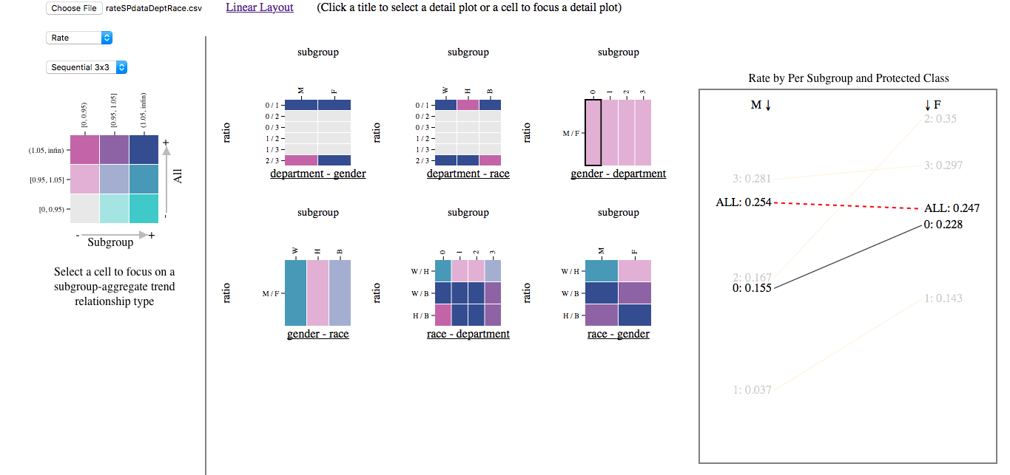
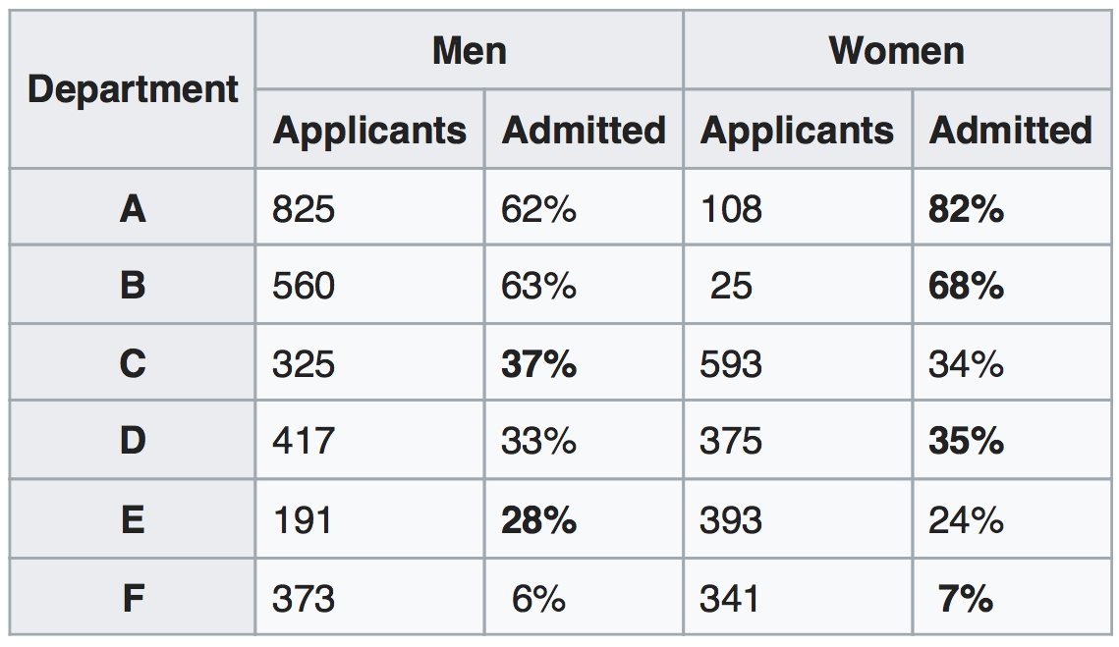
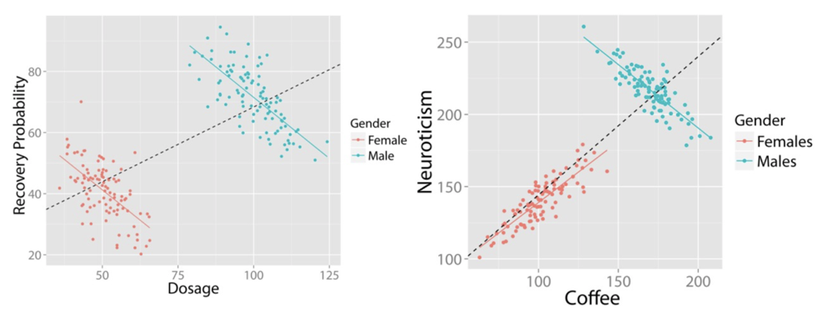
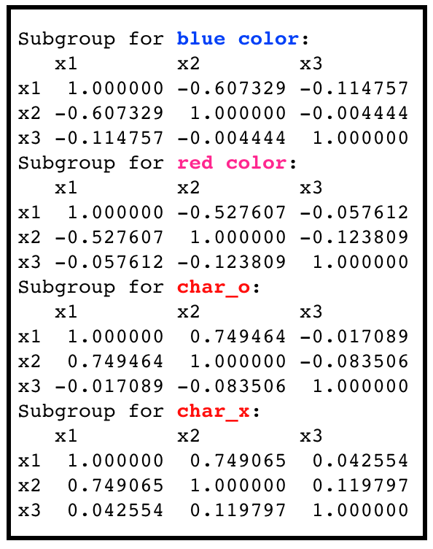
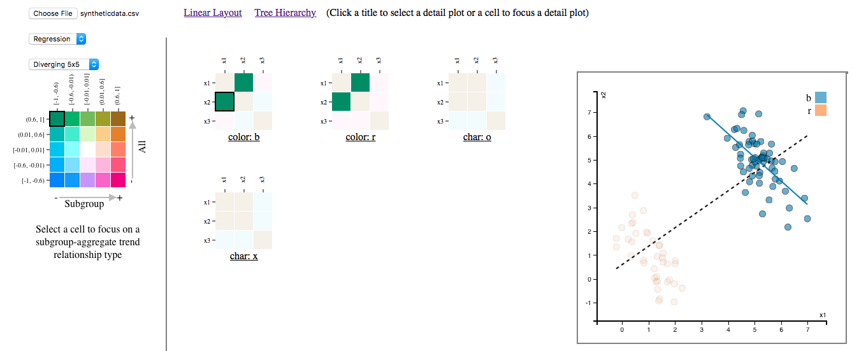
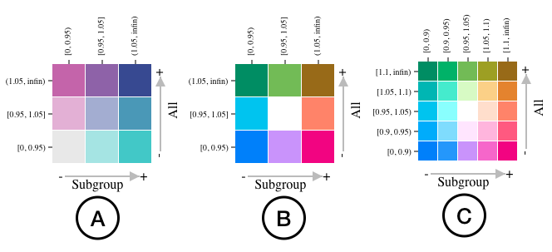
Interactive Visual Analytics for Discovering Simpson’s Paradox
Chenguang Xu, Sarah M. Brown, Chris Weaver, Christan Grant
Email: {chguxu, cweaver, cgrant}@ou.edu, smb@sarahmbrown.org
https://oudalab.github.io, https://fairnessforensics.github.io
ABSTRACT
BIVARIATE COLOR FOR CORRELATION MATRICES
Simpson’s Paradox, when subgroups of a dataset exhibit the opposite trend of the whole dataset, is a well-known and widely studied statistical phenomenon. However, as the name suggests, it is generally a surprising observation and often counter-intuitive to non-statisticians. It is increasingly important for individuals without statistical expertise to conduct exploratory analyses of data and as such, interpretable visual analytics for discovering Simpson’s Paradox are also important. This paper provides a novel visual analytics approach to facilitate the exploration of the data to detect Simpson’s paradox. We use a bivariate color scheme to illustrate the relationship between trends over the full population and within subgroups. The detection and analysis are tightly coupled by multiple coordinated views that pro-vide users with an overview of the entire data set and details as desired. The interactive features empower users to effectively and efficiently conduct exploratory analyses.
For a data set with a binary target variable, Y and for G total grouping variables, x₁, . . . x_{G}.
First, we compute the G overall comparison vectors:
Next, we partition the data set by further conditioning on each of then values of the explanatory grouping variable and compute a m × n rate comparison matrix:
SIMPSON’S PARADOX
Rate based Simpson’s paradox is a study when the trend is the relative rates of a binary outcome in two groups for example admissions by gender.
An overview of interactive visualization for rate based SP detection:
https://en.wikipedia.org/wiki
Regression type Simpson’s paradox occurs when the trend is based on the sign of a correlation between two variables.
BIVARIATE COLOR FOR RATE COMPARISON MATRICES
For a data set with d continuous variables we compute the d× d correlation matrix for the whole population. After the data set is partitioned by the C group-by variables, we compute a d× d correlation matrix for each of the k_{c} values of group-by variable c.
Kievit, Rogier A., et al. "Simpson's paradox in psychological science: a practical guide."Frontiers in psychology4 (2013).
Correlation matrix for the whole population
BIVARIATE COLOR SCHEME
A bivariate color scheme is a two dimensional array of colors that combines two sets of univariate color schemes. This configuration allows detailed comparisons of two variables and illustrates the relationship between those variables. We present a 3×3 sequential/sequential scheme (A), a 3×3 diverging/diverging scheme (B) and a 5×5 diverging/diverging scheme (C) as shown in figure below.
An overview of interactive visualization for regression based SP detection:

