Slide 1
Demographics in Social Media Data for Public Health Research: Does it matter?
Nina Cesare, Institute for Health Metrics and Evaluation
Christan Grant, University of Oklahoma
Jared B. Hawkins, Harvard Medical School
John S. Brownstein, Harvard Medical School
Elaine O. Nsoesie, Institute for Health Metrics and Evaluation

Slide 2
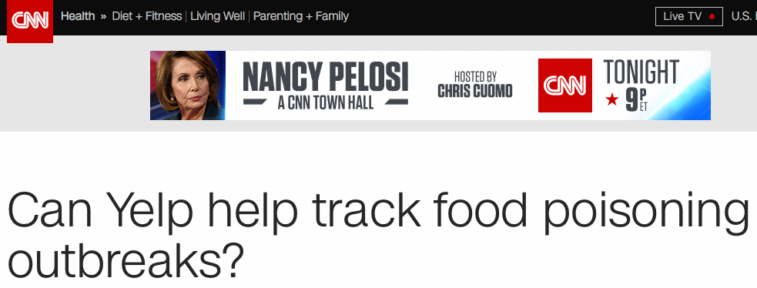
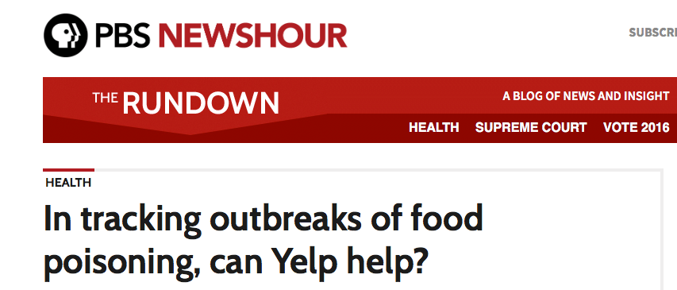
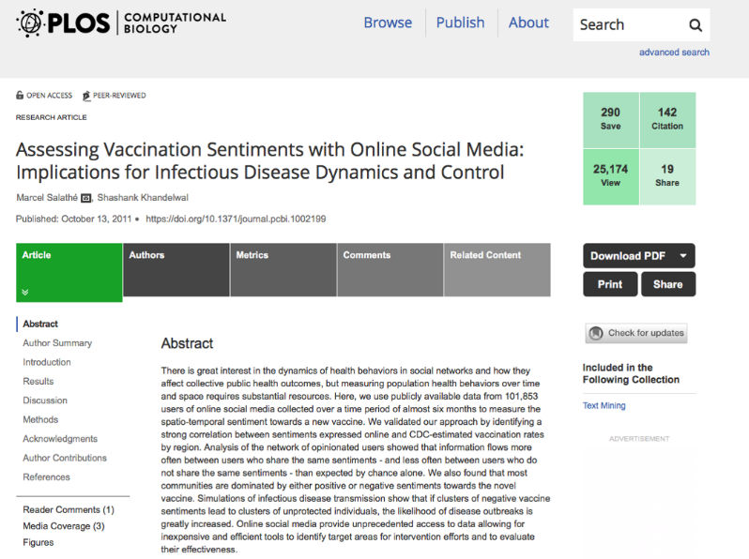
Social Media as a Public Health Sentinel

Slide 3
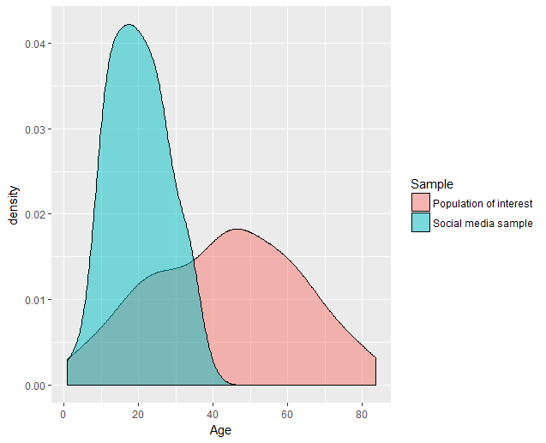
Social Media as a Public Health Sentinel
Hypothetical Data Distributions
Bias generated by digital data sources, data collection processes
Can we adjust for bias?
Need to predict demographics in a scalable and accurate way.

Slide 4
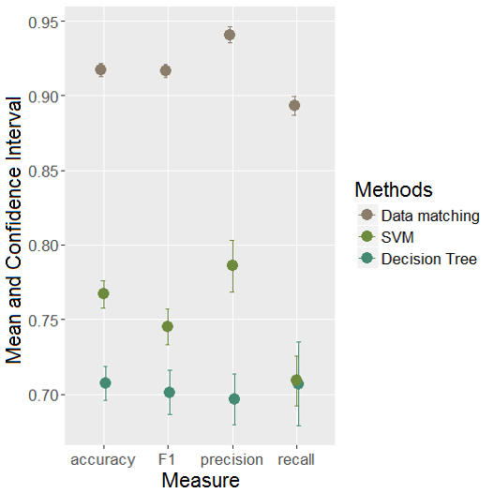
Gender Classification: A weighted ensemble approach
Method | Approach | Features from User Names
Method 1: Matching names to SSA data | Data matching | First name
Method 2: N-Grams * | SVM (linear kernel) | Word n-grams Character n-grams
Method 3: Linguistic name structure ** | Decision tree | Syllables count Vowel/consonant count Bouba/Kiki vowel/consonant count Last character is vowel
* Based on methods from Burger, Henderson, Kim and Zarella (2011)
** Based on methods from Mueller and Strumme (2016)

Slide 5
Gender Classification: A weighted ensemble approach
Classification Framework
Classification Performance
Accuracy | 0.828
Precision | 0.851
Recall | 0.852
F1 | 0.837

Slide 6
Application: Foodborne Illness
Using this ensemble classifier, we examine the gender distribution of 36,085 geotagged tweets containing symptoms of foodborne illness.

Slide 7
Application: Foodborne Illness
Gender distribution from 2010 US Census
Proportion Female
Gender distribution of Twitter users

Slide 8
Thank you!
Contact:
Nina Cesare
ninac2@uw.edu

