Slide 1
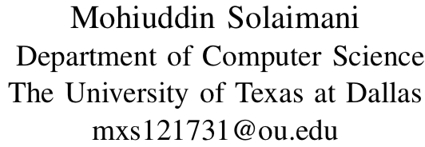
Adaptive Scalable Pipelines for Political Event Data Generation
Presenter
Ahmad Mustafa
University of Texas at Dallas
ahmad.mustafa@utdallas.edu
Notes:
Add people+labels
https://commons.wikimedia.org/wiki/File:Bangladeshi_Biryani.jpg

Slide 2
NSF #1539302 RIDIR: Modernizing Political Event Data for Big Data Social Science Research
Notes:
This work is part of a mult-iinstitutional grant NSF grant:
RIDIR: Modernizing Political Event Data for Big Data Social Science Research
The goal of the is grant is to create a general research platform to study civil protests, international conflict, and civil unrest using texts from Spanish, Arabic, and French, in addition to English.

Slide 3
Outline
Political Event Extraction
Pipeline Architecture
Kalman Filter
Optimizations
Summary

Slide 4
Political Events
Governments, Social Scientists, and Political Scientist are interested in studying events around the world.
Researchers spend spend many hours compiling and analyzing news documents.
This grant came into an agreement with Lexis Nexis to obtain a large collection of US, multilingual, and International news documents.
Notes:
News articles published on the web give social scientists in academia and government the ability to measure and understand political events around the world.
Sometimes finding non-bias and obscure sources are difficult.
The University of Oklahoma came into an agreement with Lexis Nexis, a publishing company, to obtain millions of obscure and local papers from the over the last 40 years.

Slide 5
Political Event Extraction
A town in western Sudan's South Kordofan state has been recaptured by Sudanese government forces from the rebel Sudan People's Liberation Army (SPLA)
Actor | Event | Target
Sudanese Military | Capture Territory | Sudans People’s Liberation Army
Notes:
Conflict and Mediation Event Observations → Codes based on dictionaries and ontologies that are optimized for conflict resolution.
http://eventdata.parusanalytics.com/papers.dir/Gerner.APSA.02.pdf

Slide 6
Goal
Create pipeline to help non-cs people extract political events.
Make the pipeline work on extremely large and small data.
Requirements
Should use MongoDB.
Must be deployable locally.
Notes:
The Goal of this work is to create a pipeline that will allow non-computer scientists to extract both small and large amounts of political events from news documents.
Because of the users of the pipeline we had requirements that the system:
Must use MongoDB
Must be deployable locally on laptops and desktop machines

Slide 7
Biryani Pipeline
A pipeline to manage the scalability, execution, of event extraction.
Uses Docker and Docker-compose to facilitate execution of threads and batches.
Optimization allow the system to adapt to changes in system configuration and workload.
Notes:
<See bullets>
Containerizing and distributing the processing step has several advantages in addition to the ability to distribute across machines: the per-container threads, batch size, and memory can be adapted to increase processing speed, containers can be automatically restarted on failure, and the architecture becomes

Slide 8
Biryani Architecture
Notes:
Figure 1 displays the components of the system. Raw data is uploaded from webpages into a MongoDB. This is a common interface for storing data but it is not essential to the Biryani system. Data is transferred from Mongo or an API to a RabbitMQ. This queue is a persistent storage and the entry point to Biryani. Containers are spun up as consumers of the data queue. The containers run the Stanford CoreNLP process with multiple threads. The data in each container is written to a local SQLite database.
Not shown: logging using the ELK stack (Elasticsearch, Logstash, and Kibana)

Slide 9
Optimizations: Kalman Filter
Optimal estimation algorithm
Inputs:
Number of documents read at a time (batch).
Observation: Time taken for a batch.
Output:
Updated batch size.
Notes:
Optimal estimation algorithm that predicts a parameter of interest
Note: we also tried optimizing threads but we did not see great performance.

Slide 10
Experiment Environment
Machines
Processing machine: Intel® Core™ i7-6950X CPU @ 3.00GHz CPU with 20 total cores and 126 GBs of RAM
Data Storage: Intel® Xeon® CPU X5687 @ 3.60GHz with 16 total cores and 96 GBs of RAM
Laptop: Intel® Xeon® CPU @ 2.30GHz, 4 cores, and 16GB of RAM.
Data Sets
English Gigaword corpus (4 Million Documents, 12 gigabytes)

Slide 11
Experiments
Experiment 1: Optimal and thread batch size.
Experiment 2: Kalman Filter performance.
(Creation of the Terrier Dataset)

Slide 12
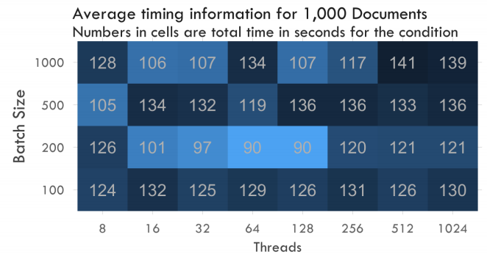
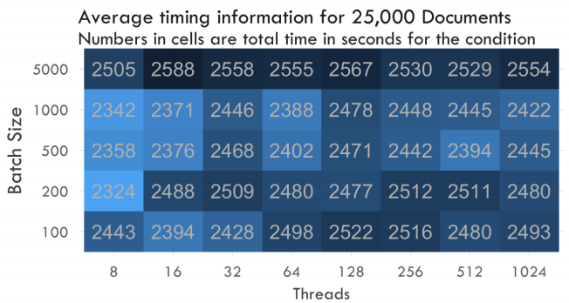
Thread and Batch Size
The experiments measures total run time for 1K and 25K documents.
(Lighter and smaller means faster)
We see clear optimal choices for batch sizes and thread size that change over time.
Thread count affected timing less than batch.
This motivates a system to adapt to changing the workload.
Notes:
The experiment over a 1K documents show a clear optimum at 200 Batch
Larger experiment showed batch optimums also exist.

Slide 13
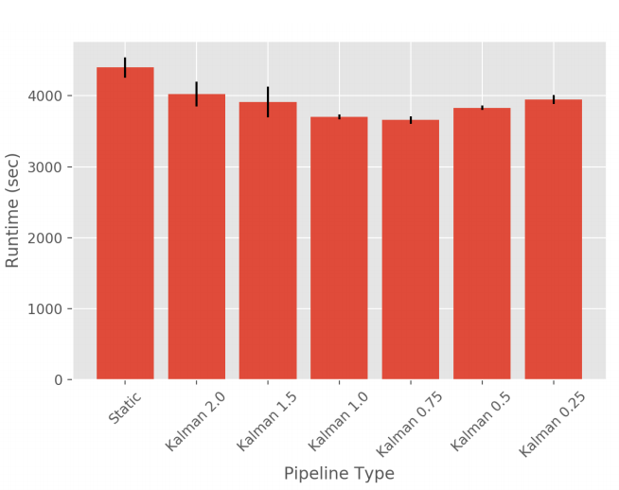
Kalman Filter Performance
Adding a Kalman filter over the batch sizes shows a performance gain.
Compared against a sorted, static data set (best possible performance)
Performance gains of up to 20.33% on a laptop-style configuration.
Some hyper parameter tuning of the Kalman filter is required. But defaults work well.
Notes:
See bullts.
Note: we compare against sorted document sizes

Slide 14
Summary
We combined scalable container-based pipeline with adaptable .
We added a optimization filter to automatically manage the processing.
We used this pipeline to create one of the largest political event datasets available.
Political scientist can also use Biryani to generate their own data sets.

Slide 15
Coming Spring 2018 …
Email jill.Irvine@ou.edu for access
Notes:
Political Events from 1975-2015
We expect more than 1-10 Billion events

Slide 16
Thank you!

Slide 17
Questions?

Slide 18
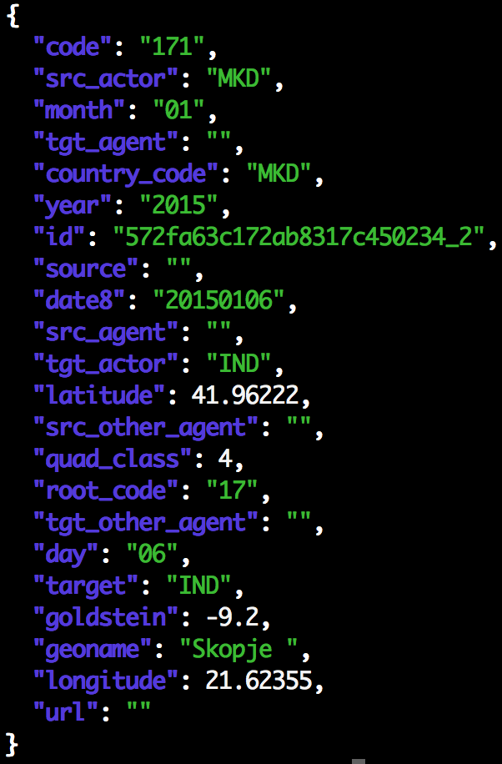
TERRIER Creation
TERRIER is a machine-coded political event dataset covering 1979 to 2015
Event data records the interactions between political actors that are reported in news text
Terrier creation used Biryani and Birdcage
~ 900K sample is available now
Uses the CAMEO ontology for actor/action representation
It includes the complete archives of all major US and international newspapers and wire services going back to the 1970
Will be the largest data set of its kind
May 2018 Adding Arabic and Spanish (ISA)
Notes:
Macedonia Coercing IND

Slide 19
References
Biryani Figure https://commons.wikimedia.org/wiki/File:Bangladeshi_Biryani.jpg
Protest https://www.flickr.com/photos/johnnysilvercloud/28476745294

